Slide 1
Why Use MLA Format?
Allows readers to cross-reference your sources easily
Provides consistent format within a discipline
Gives you credibility as a writer
Protects yourself from plagiarism
Purdue University Writing Lab

Slide 2
Using a Consistent Format
Using a consistent format helps your reader understand your arguments and the sources they’re built on.
It also helps you keep track of your sources as you build arguments.
Purdue University Writing Lab
Notes:
‹#›

Slide 3
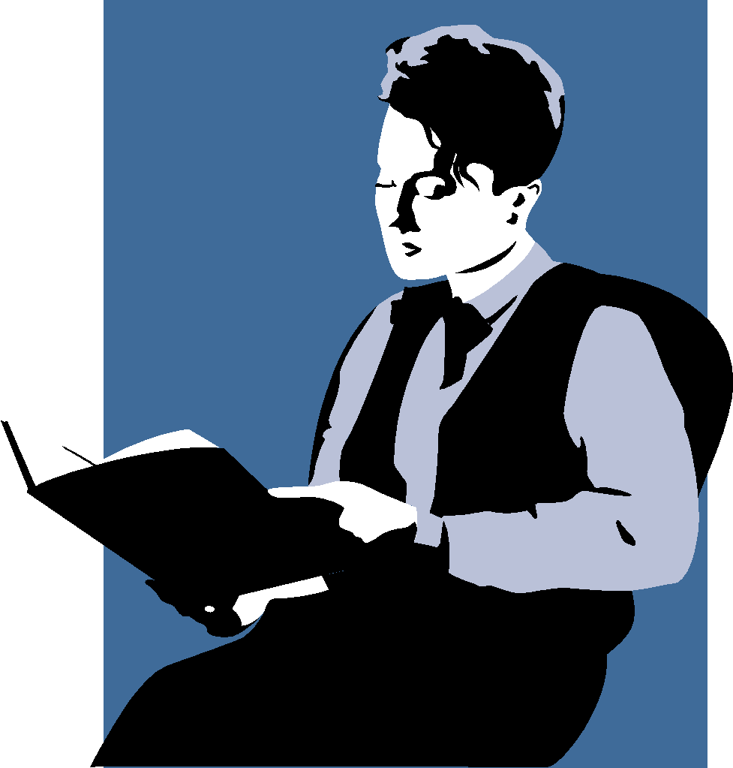
Establishing Credibility
The proper use of MLA style shows the credibility of writers; such writers show accountability to their source material.
Purdue University Writing Lab

Slide 4
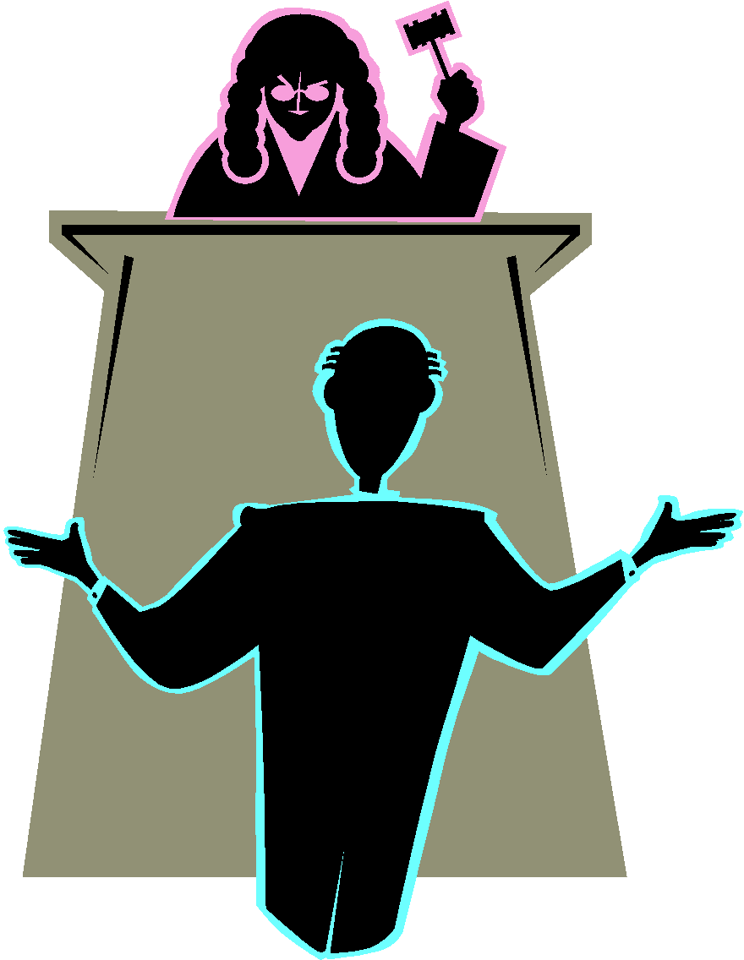
Avoiding Plagiarism
Proper citation of your sources in MLA style can help you avoid plagiarism, which is a serious offense. It may result in anything from failure of the assignment to expulsion from school.
Purdue University Writing Lab
Notes:
‹#›

Slide 5
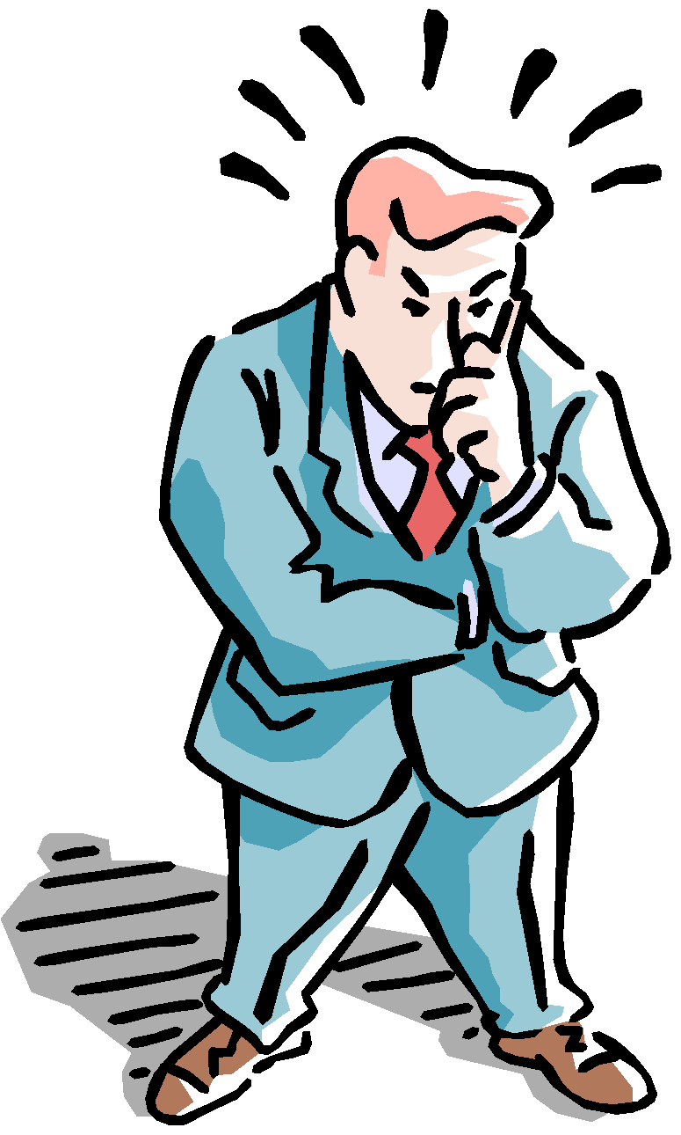
Where Do I Find MLA Format?
MLA Handbook for Writers of Research Papers, 5th ed.
Composition textbooks
www.mla.org
OWL website: owl.english.purdue.edu
CITATION Machine www.citationmachine.net/mla/cite-a-website

Slide 6
MLA Citation—When?
When do I cite sources?
You cite your sources any time you take information or ideas from another person to use in your own work.
-Quotes
-Statistics
-Charts/Graphs/Images
-Paraphrasing
-IDEAS

Slide 7
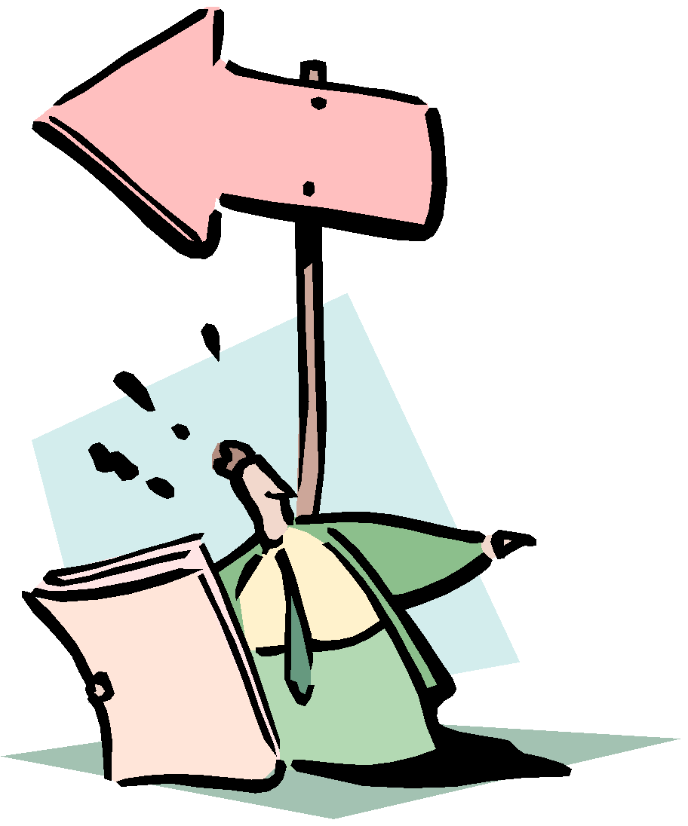
MLA Style: Two Parts
Works Cited Page
Parenthetical Citations
Purdue University Writing Lab
Notes:
‹#›

Slide 8
Works Cited Page
A complete list of every source that you make reference to in your essay
Provides the information necessary for a reader to locate and retrieve any sources cited in your essay.
Purdue University Writing Lab
Notes:
‹#›
Rationale: This slide shows the basic information needed for entries on the works cited page.

Slide 9
Works Cited Citations MLA
Your works cited page will come at the very end of your paper/project.
These citations include all the information that will help your audience find your sources if they want.
As you research, it is important to keep notes about your sources if you plan to use them.

Slide 10
Works Cited
Most citations should contain the following basic information:
Author’s name
Title of work
Publication information
Purdue University Writing Lab

Slide 11
Works Cited Citations MLA
You will need slightly different information and organization depending on where your source came from. Let’s see some of the most common:
You got your information from a book and the book had only 1 author:
AuthorLastname, AuthorFirstname. Title of Book. City of Publication: Publisher, Year of Publication. Medium of Publication.
Henley, Patricia. The Hummingbird House. Denver: MacMurray, 1999. Print.

Slide 12
Works Cited Citations MLA
You got your information from a scholarly journal:
TWO AUTHORS:
FirstAuthorLastName, FirstAuthorFirstName, and SecondAuthorFirstName SecondAuthorLastName. "Title of Article." Title of Journal Volume.Issue (Year): pages. Medium of publication.
Bagchi, Alaknanda and John Doe. "Conflicting Nationalisms: The Voice of the Subaltern in Mahasweta Devi's Bashai Tudu." Tulsa Studies in Women's Literature 15.1 (1996): 41-50. Print.

Slide 13
Works Cited Citations MLA
You got your information from a website:
Editor/author/compiler name. “Title of Webpage.” Name of Website, date of resource creation/publication. Medium of publication. Date of access.
Doe, Jane. "How to Make Vegetarian Chili." eHow. Demand Media, n.d. Web. 24 Feb. 2009.
**Note: n.d. means date is not available.

Slide 14
Works Cited Citations MLA--FAQ
How do I alphabetize it?
Alphabetize it using the first word of the citation, whether that is the author’s names or the title of the source. It should be alphabetized from A-Z.

Slide 15
Works Cited Citations MLA--FAQ
How do I format it?
After you have it alphabetized, you need to double space it.
For each citation that is MORE THAN ONE LINE, you need to indent all but the first line (1 “tab” or 5 spaces)

Slide 16
A Sample Works Cited Page
Smith 12
Works Cited
Dickens, Charles. Bleak House. 1852-1853. New York: Penguin,
1985.
---. David Copperfield. 1849-1850. New York: Houghton Mifflin
Company, 1958.
Miller, J. Hillis. Charles Dickens: The World and His Novels.
Bloomington: U of Indiana P, 1958.
Zwerdling, Alex. “Esther Summerson Rehabilitated.” PMLA 88 (May
1973): 429-439.
Purdue University Writing Lab

Slide 17
In-Text Citations
You also need to cite your sources in the body of the paper. We call these “in-text” citations or parenthetical citations.
You need in-text citations after each time you use or reference a quote, statistic, idea, image, chart, etc.
You must cite in-text EVEN IF YOU PARAPHRASE.

Slide 18
In-Text Citations
Two different ways:
If you mention the author in the sentence, you only have to put the page number in parentheses at the end of :
Walcott concluded that “increasing the tax on luxury items like cigarettes decreased the general public’s use of those items” (45).
Notice that the parentheses come AFTER the quotation mark and before the period.

Slide 19
In-Text Citations
2) If you do not mention the author in the sentence, you need to put the author’s LAST name and page number at the end of the sentence:
According to studies, “increasing the tax on luxury items like cigarettes decreased the general public’s use of those items” (Walcott 45).
Notice that the parentheses come AFTER the quotation mark and before the period.

Slide 20
In-Text Citations
Note: even if you just paraphrase (do not use quotation marks), you still need in-text citations.
According the Walcott, people will stop using luxury items if we increase the tax associated with them (45).
Notice that the parentheses still come before the period.

Slide 21
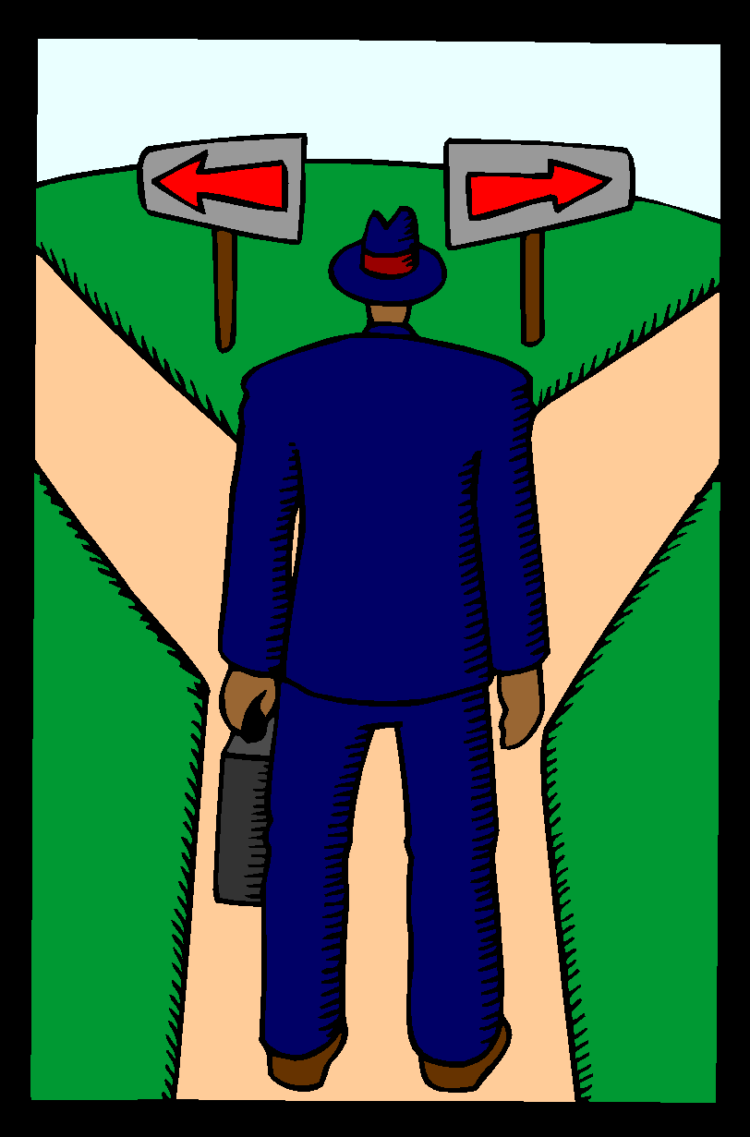
When Should You Use Parenthetical Citations?
When quoting any words that are not your own
Quoting means to repeat another source word for word, using quotation marks
Purdue University Writing Lab
Notes:
‹#›
Rationale: This slide establishes the two areas of MLA documentation, the Works Cited page and parenthetical citations.

Slide 22
When Should You Use Parenthetical Citations?
When summarizing facts and ideas from a source
Summarizing means to take ideas from a large passage of another source and condense them, using your own words
When paraphrasing a source
Paraphrasing means to use the ideas from another source but change the phrasing into your own words
Purdue University Writing Lab

Slide 23
Handling Parenthetical Citations
Sometimes more information is necessary
More than one author with the same last name
(W. Wordsworth 23); (D. Wordsworth 224)
More than one work by the same author
(Joyce, Portrait 121); (Joyce, Ulysses 556)
Different volumes of a multivolume work
(1: 336)
Citing indirect sources
(Johnson qtd. in Boswell 2:450)
Purdue University Writing Lab
Notes:
‹#›
Click to reveal each item.

Slide 24
Handling Parenthetical Citations
If the source has no known author, then use an abbreviated version of the title:
Full Title: “California Cigarette Tax Deters Smokers”
Citation: (“California” A14)
If the source is only one page in length or is a web page with no apparent pagination:
Source: Dave Poland’s “Hot Button” web column
Citation: (Poland)
Purdue University Writing Lab
Notes:
‹#›

Slide 25
MLA Formative #1
In a group, you will receive a packet consisting of several pieces of an MLA citation.
Each person in your group needs to have 1-2 pieces.
Arrange yourselves in a line (yes, you will have to stand up) holding the pieces in the correct order.
You may use your reference sheet.
The first team to correctly arrange themselves will receive a treat.
To show that you are finished, silently hold your arms in the air with the pieces.

Slide 26
Answers
Purdue University Writing Lab

Slide 27
Corrected CITATION
Corrected Manipulates
Martin, Pearl, and Sonia Jackson. "Educational Success for Children in Public Care: Advice from a Group of High Achievers." Child and Family Social Work 7.2 (2002): 121-30. Web. 15 Nov. 2006.

Slide 28
CORRECTED CITATION
Jans, Nick. The Last Light Breaking: Life among Alaska's Inupiat Eskimos. Anchorage: Alaska Northwest Books, 1993. Print.
Purdue University Writing Lab

Slide 29
CORRECTED CITATION
Forman, Jackson. "Allston Gothic." Boston Globe 12 Aug. 2003. Web. 12 June 2006.

Slide 30
CORRECTED CITATION
"Global Sea Turtle Populations Decline." Sea Turtle Restoration Project. 26 May 2002. Web. 22 Sept. 2006.

Slide 31
CORRECTED CITATION
According to Brown, “Politicians use the red herring logical fallacy more often when they feel like they are losing a debate” (65).

Slide 32
Formative 2
1) An article on pages 24-31 of the print magazine 20th Century Travel by Karen Pankratz called “Destination: Athens.” It was published on March 3rd, 2002.
2) An Internet article with no author called “Famous Greek Battles.” It was published on June 14, 2009, viewed on January 12, 2004 published by the Humanities Department at Cornell University.
WITH YOUR PARTNER, USE CITATION MACHINE ON YOUR PHONE TO GET THE CORRECT CITATION.

